Slide 1
Game Analytics Pipeline
KPI Analysis
Yiwei Ye

Slide 2
Pipeline Architecture
Unity
Simulator
Analytics
Manager
PHP
Backend
MySQL
Database
R
Analysis
Non-intrusive event subscription
Async coroutines (Unity → PHP)
Prepared statements (SQL injection prevention)
Normalized database schema
2/10

Slide 3
Database Design
users
sessions
user_id (PK)
username
country
age
gender
registration_date
session_id (PK)
user_id (FK)
start_time
end_time
purchases
items
purchase_id (PK)
user_id (FK)
item_id (FK)
amount
purchase_date
item_id (PK)
item_name
price
category
4 Tables | 3 Foreign Keys | 4 - 5 Indexes
3/10

Slide 4
Data Quality
1,007
12,611
1,272
Total Users
Total Sessions
Purchases
364 days coverage | 51 countries | Zero orphaned records
Full Year 2022 - Complete temporal coverage
Data Quality - referential integrity
99.99% Complete Sessions - Robust data collection
Global Reach - 51 countries represented
4/10

Slide 5
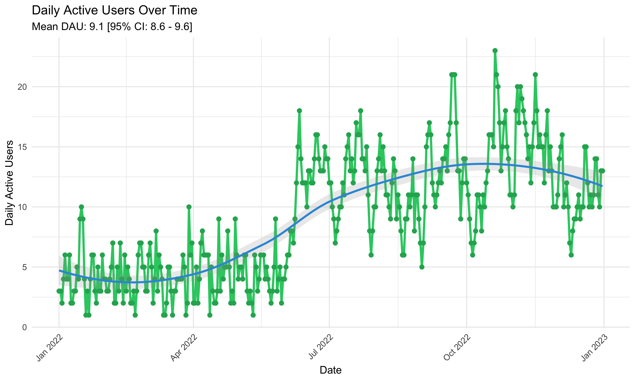
User Engagement
9.1
Mean DAU
[8.6-9.6]
88.8
Mean MAU
[82.8-94.7]
10.2%
Significant Surge Since July 2022
Stickiness Ratio
Stable engagement with 12.5 sessions per user throughout 2022
5/10

Slide 6
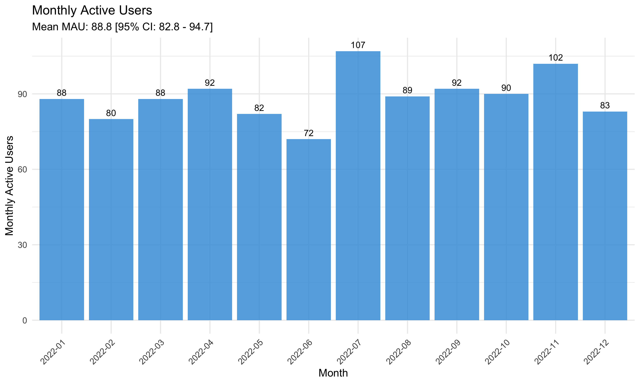
User Engagement
9.1
Mean DAU
[8.6-9.6]
88.8
Mean MAU
[82.8-94.7]
10.2%
Significant Surge Since July 2022
Stickiness Ratio
Stable engagement with 12.5 sessions per user throughout 2022
5/10

Slide 7
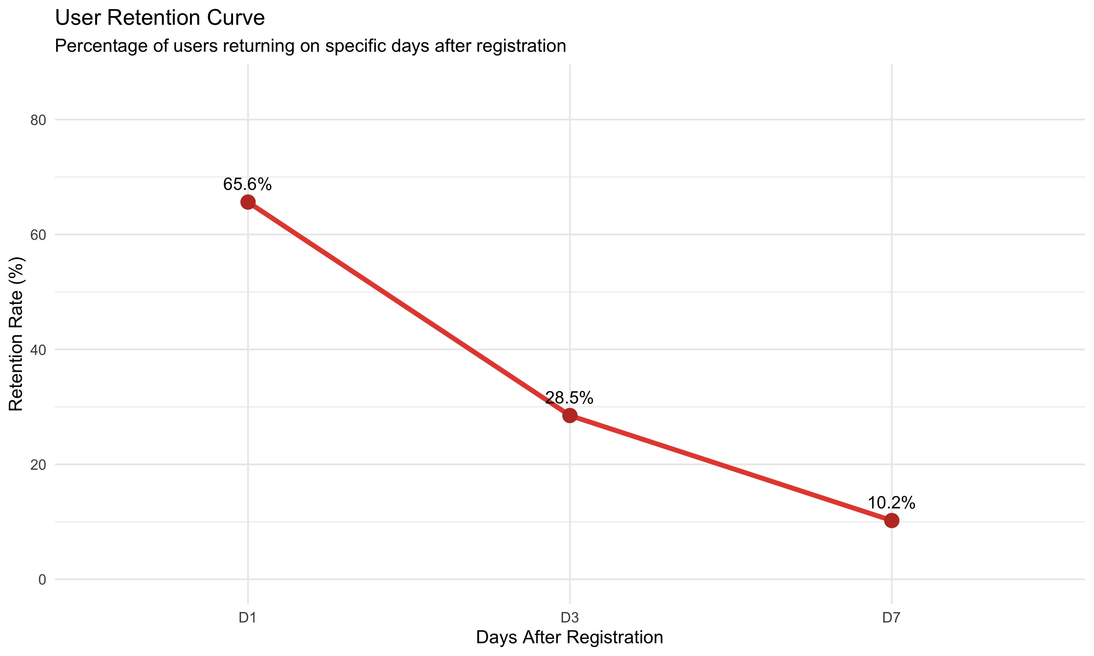
Excellent Retention
10.2% D7 Retention – Solid with Growing Potential
Solid product-market fit - users who try, stay
6/10

Slide 8
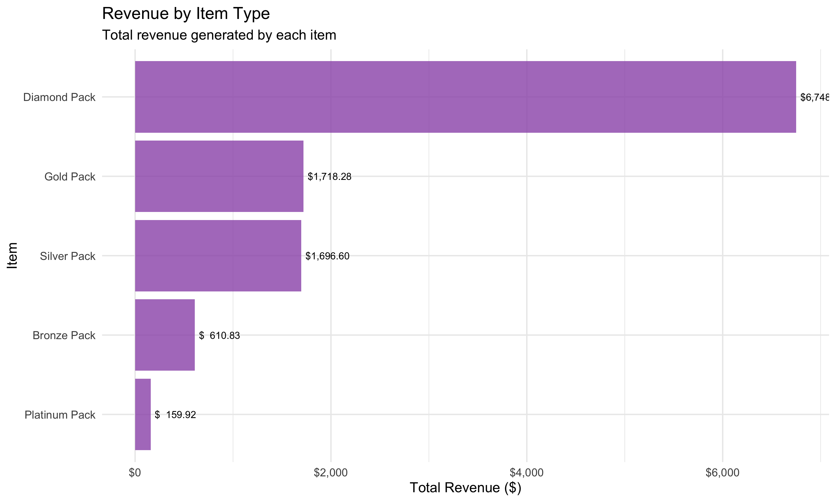
Monetization Success
$10.86
$21.07
51.5%
$10.9K
ARPU
ARPPU
Conversion
Total Revenue
Diamond Pack ($49.99) drives 62% of revenue - premium monetization works
7/10

Slide 9
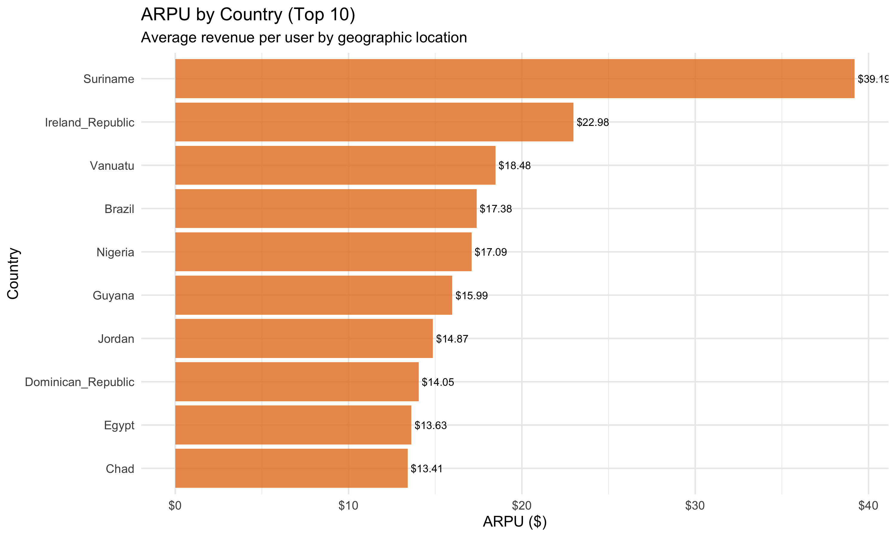
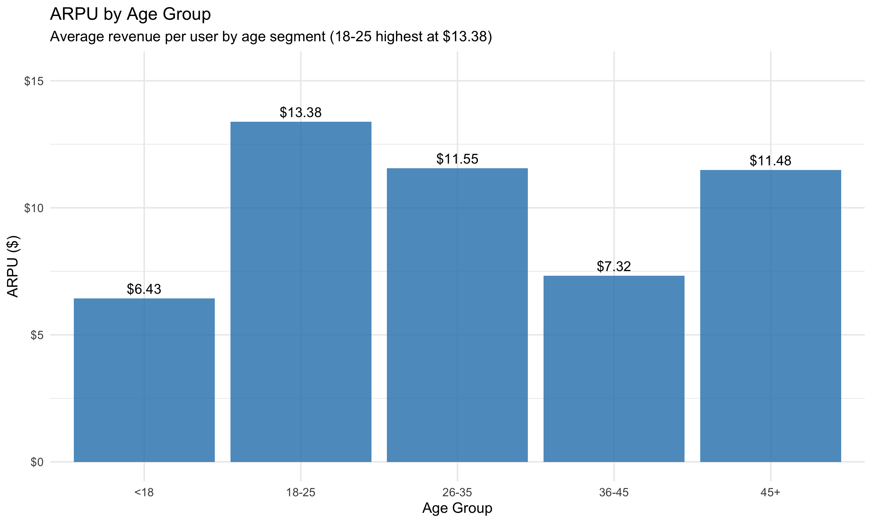
Monetization Success
$10.86
$21.07
51.5%
$10.9K
ARPU
ARPPU
Conversion
Total Revenue
Further Clue Aggregated by Country and Age Group
7/10

Slide 10
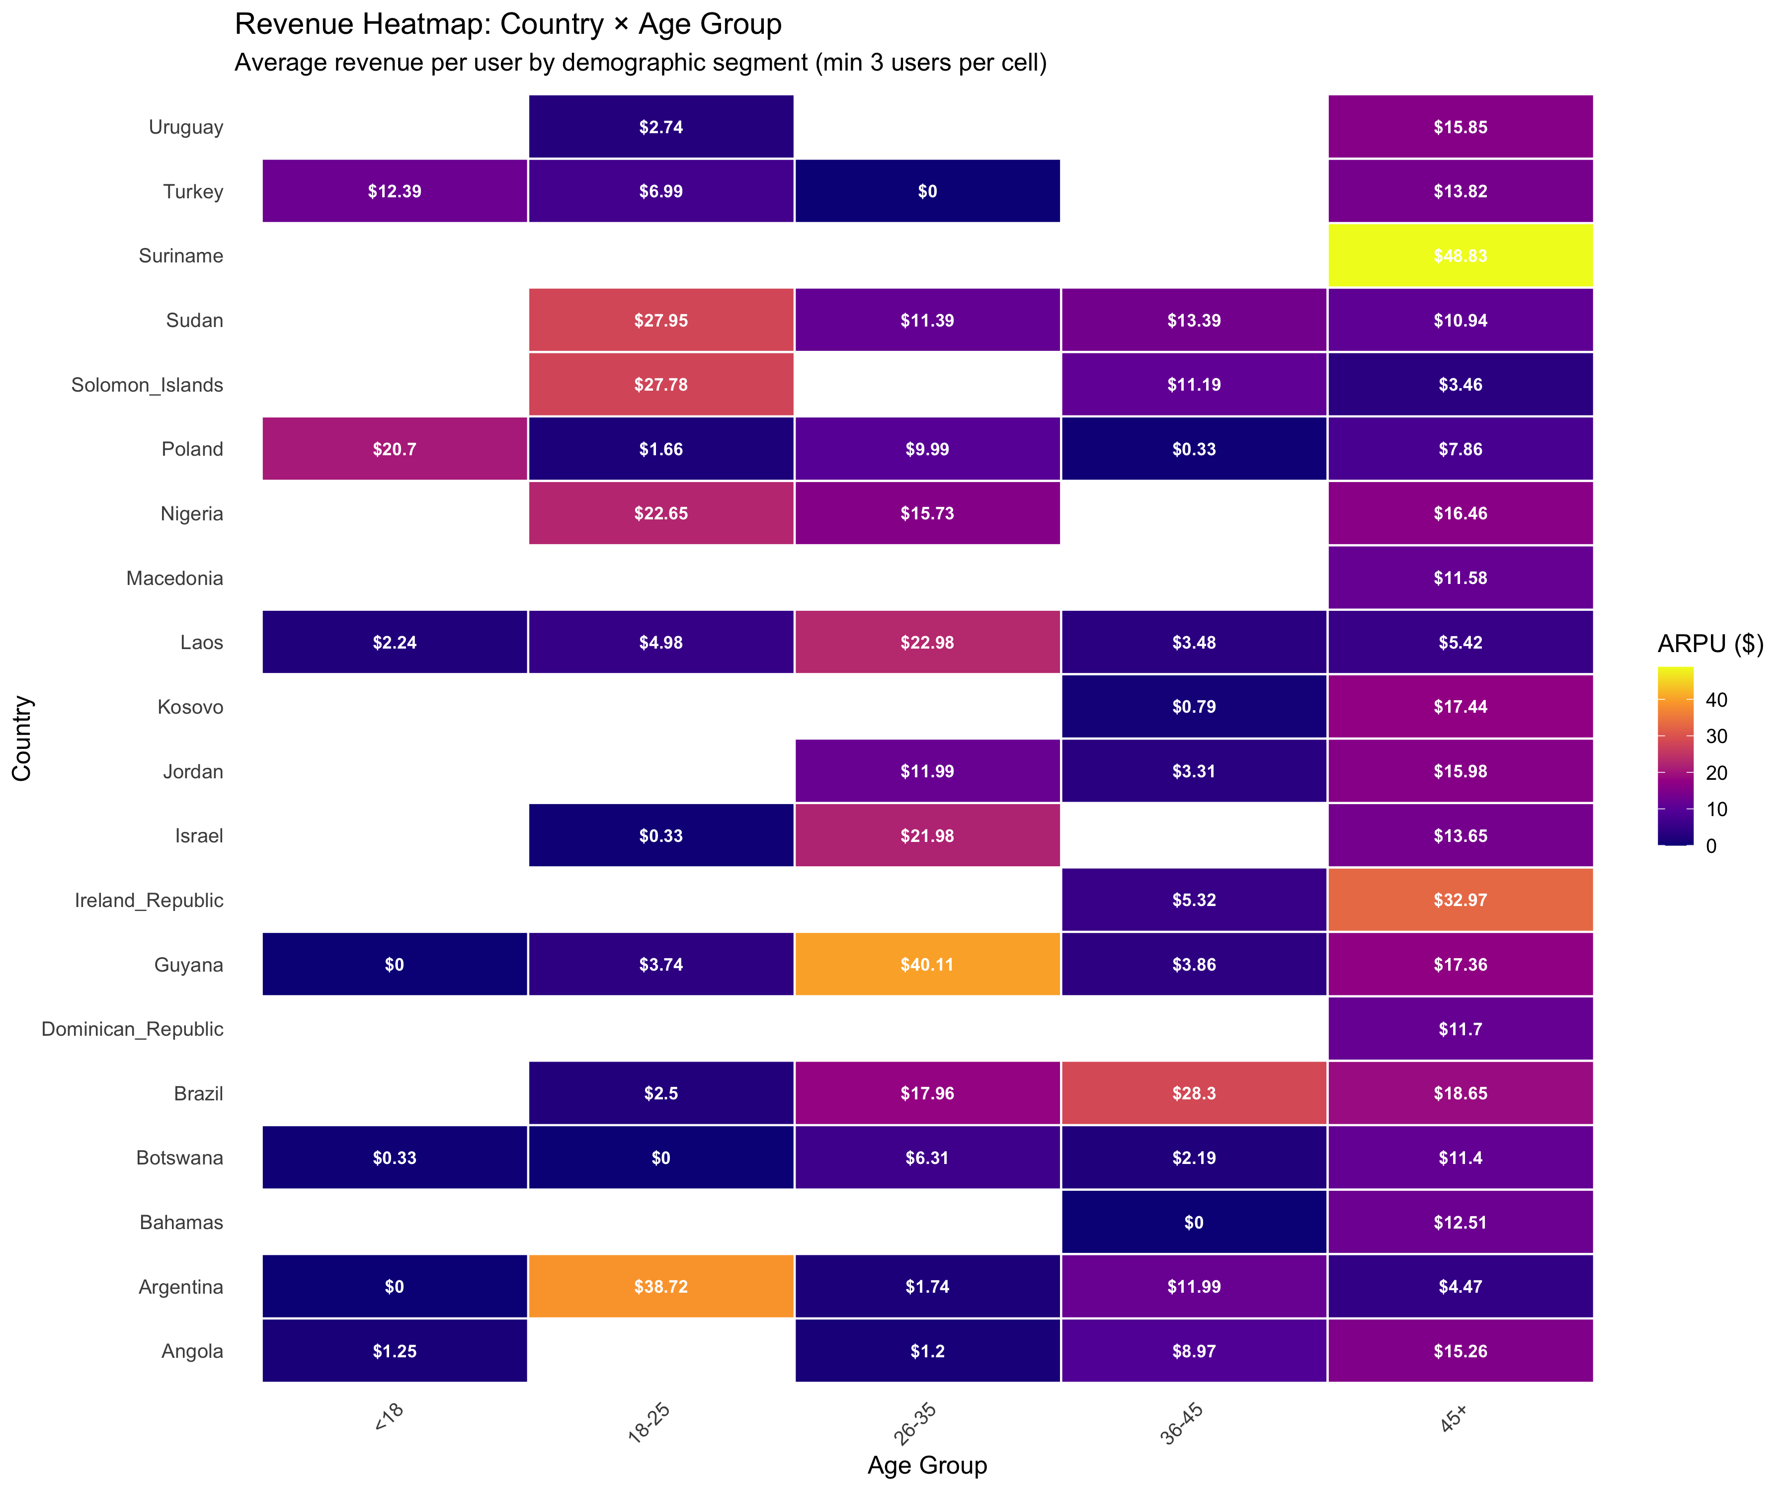
High-Value Demographics
Top Markets:
• Suriname: $39.19 ARPU
• Ireland: $22.98 ARPU
Best Age Group:
• 18-25: $13.38 ARPU
High-Value Profile:
Ireland + 18-25 age
8/10

Slide 11
Key Findings & Recommendations
10.2% D7 retention → Protect core gameplay loop
51.5% conversion → Focus on ARPPU growth, not conversion
Diamond Pack dominance → Expand $50-$100 premium tier
Geographic winners → Target Ireland, Suriname, Brazil for UA
Action: Scale premium monetization for +31% revenue potential
9/10

Slide 12
Conclusion
Gather & Store
Pipeline Limitations
Normalized DB with proper indexes
Non-intrusive async data transmission
Simulated data
SOLID principles & modular code
Sample size of 100 users/cycle
Analytics
Correct KPI calculations with 95% CI
Short time window
Statistical rigor & hypothesis testing
Efficient, reusable SQL queries
No experimental design
Reporting
Clear visualizations & insights
Retention metrics limited by simulation time constraints
Actionable business recommendations
Production-ready analytics pipeline converting data into $3K+ revenue opportunities
10/10

Slide 13
thank you

